Slide 1
Research
Phenomenological investigation of fracture dynamics in 3D
Integrate fracture dynamics in reservoir simulation
Remarks
Geomechanics effects are often analyzed with more complexity than necessary for conventionals
Need an application where geomechanics is relevant and cannot be handled by linear tables for porosity/permeability or plane strain simulation
Application ideas
Non-isothermal water/gas injection in carbonates (NFR)
Fracture propagation and fluid containment with salt as caprock
PAPER RECOMMENDATION: SPE219461

Slide 2
Strategy
develop simulation routines gradually
find intermediate applications for valitation and maturing
Starting point
The elastic homogenization application we are working on
Where we are
Validation went through
Mesh generator used to work …
Next step
Generate meshes
Run simples testcases

Slide 3
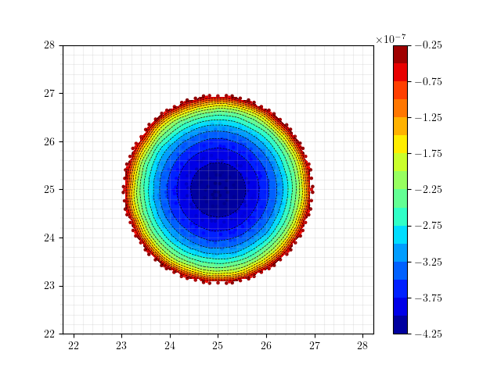
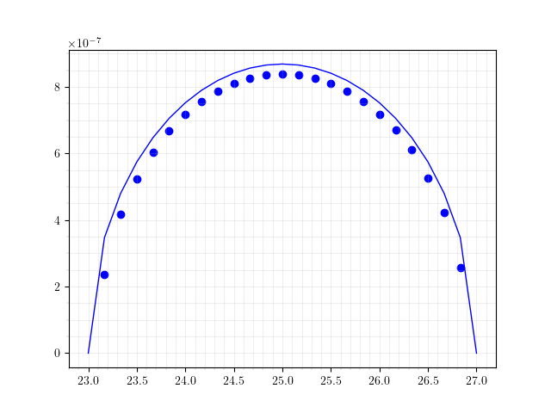
SNEDDON, COARSE MESH
Book (VALKO, ECONOMIDES)
Mesh Information:
elem_dimensions()={3}
spatial_dimension()=3
n_nodes()=13086
n_local_nodes()=3829
n_elem()=9138
n_local_elem()=2285
n_active_elem()=9138
Time: 10s
Maximum UZ displacement: 4.1952e-07
WMAX: 4.3450e-07
ERR: -3.45 %

Slide 4
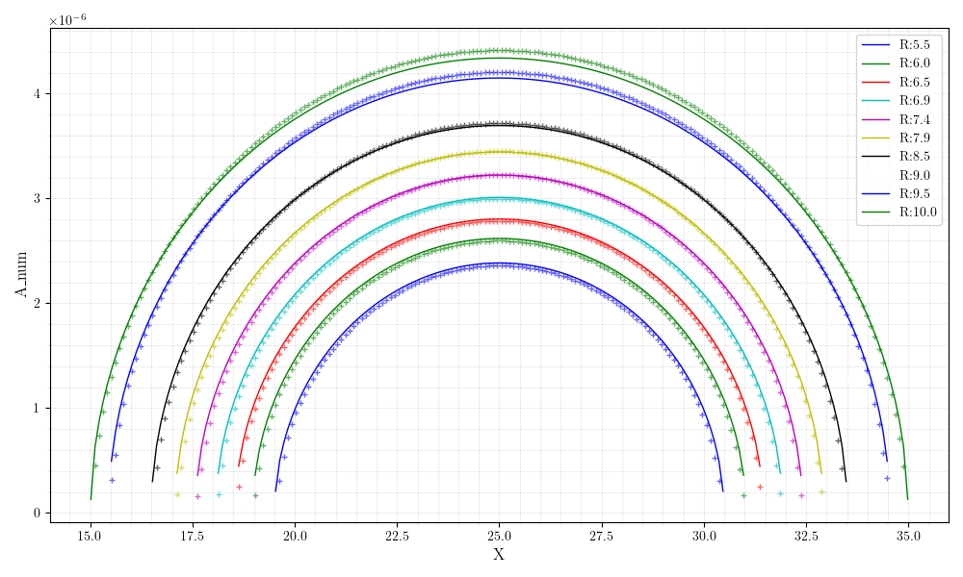
SNEDDON, Mesh sentitivity

Slide 5
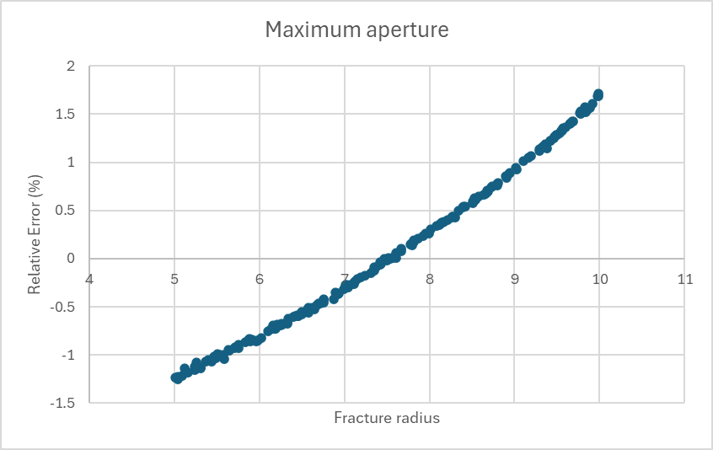
SNEDDON, Mesh sentitivity

Slide 6
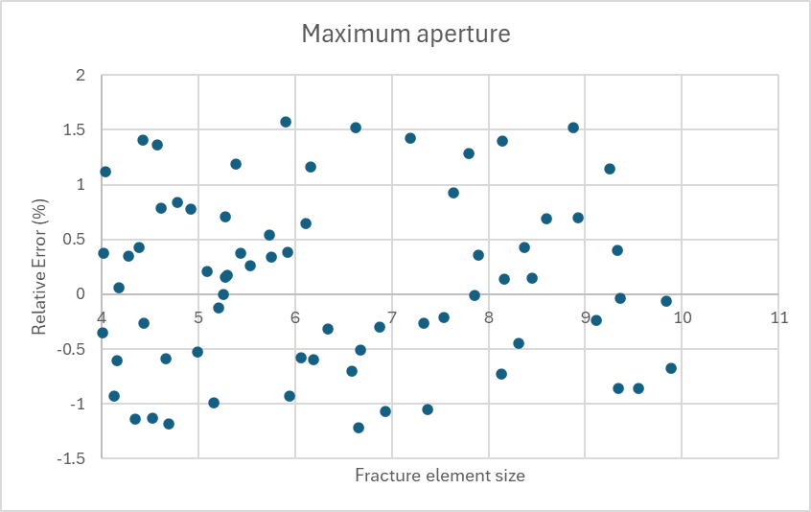
SNEDDON, Mesh sentitivity

Slide 7
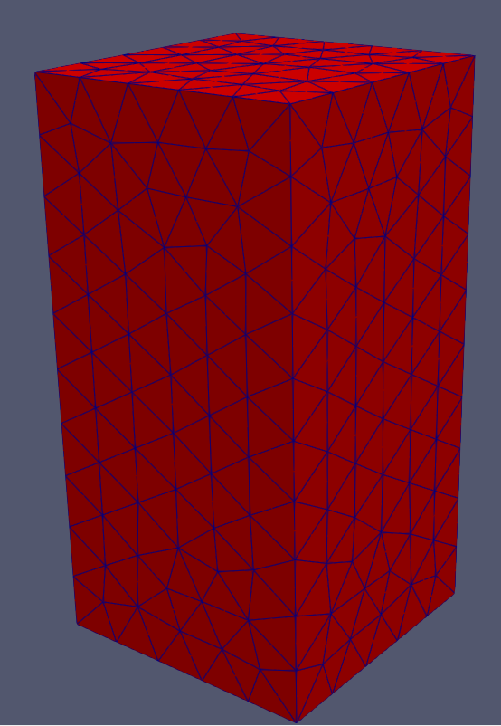
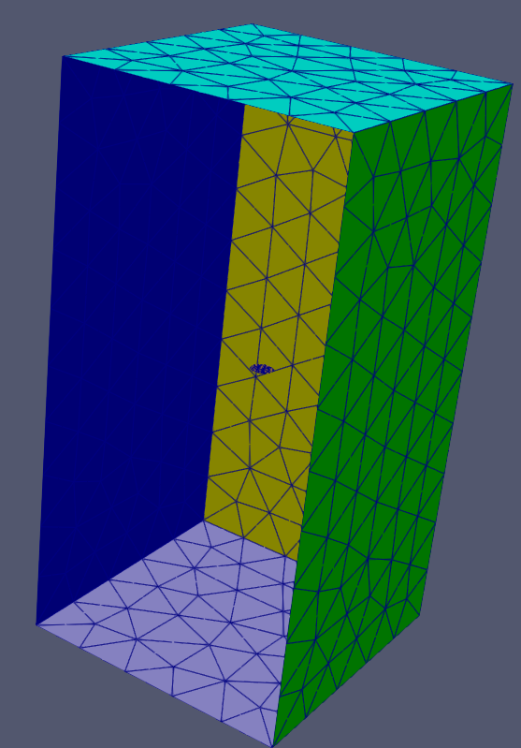
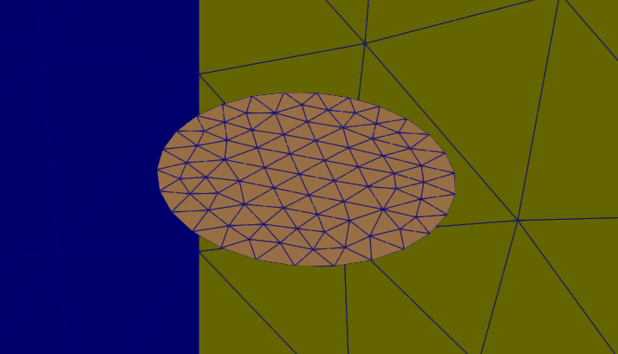
SNEDDON, COARSE MESH
ISOGEOMETRIC ANALYSIS?
Mesh Information:
elem_dimensions()={3}
spatial_dimension()=3
n_nodes()=13086
n_local_nodes()=3829
n_elem()=9138
n_local_elem()=2285
n_active_elem()=9138
Time: 10s
Maximum UZ displacement: 4.1952e-07
WMAX: 4.3450e-07
ERR: -3.45 %

Slide 8
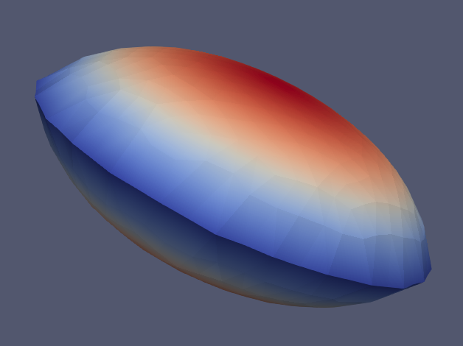
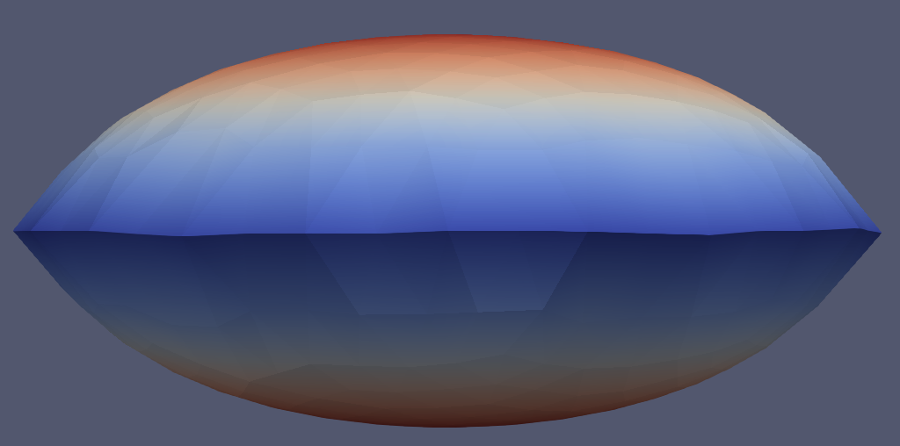
SNEDDON, COARSE MESH
Mesh Information:
elem_dimensions()={3}
spatial_dimension()=3
n_nodes()=13086
n_local_nodes()=3829
n_elem()=9138
n_local_elem()=2285
n_active_elem()=9138
Time: 10s
Maximum UZ displacement: 4.1952e-07
WMAX: 4.3450e-07
ERR: -3.45 %

Slide 9
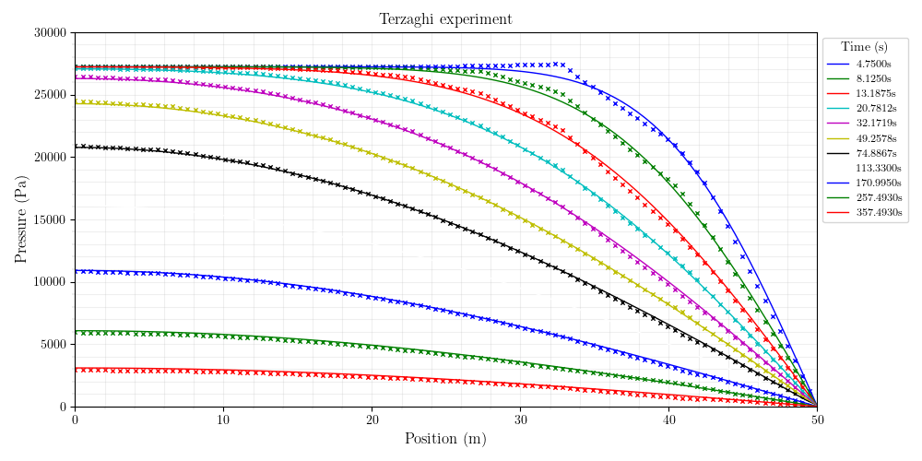
Mesh Information:
elem_dimensions()={3}
spatial_dimension()=3
n_nodes()=1798
n_local_nodes()=515
n_elem()=942
n_local_elem()=235
n_active_elem()=942
TERZAGHI, CRANK NICHOLSON (9s)

Slide 10
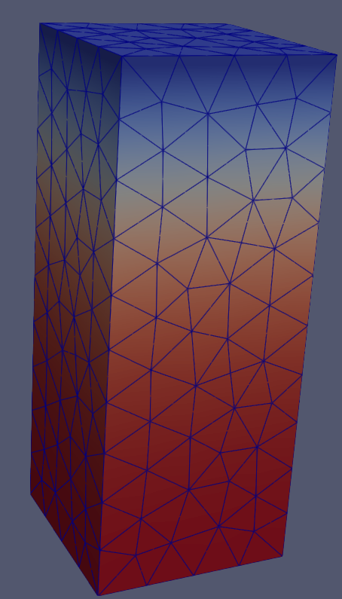
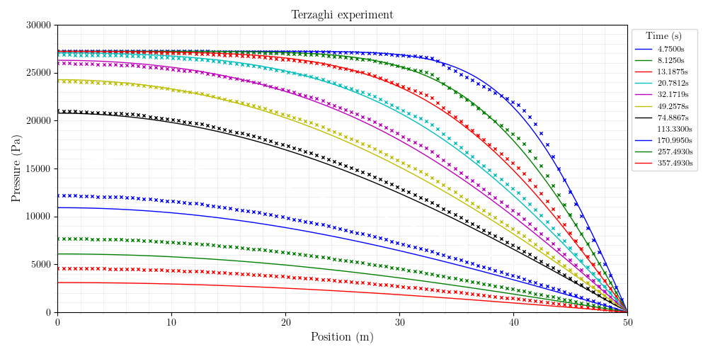
Mesh Information:
elem_dimensions()={3}
spatial_dimension()=3
n_nodes()=1798
n_local_nodes()=515
n_elem()=942
n_local_elem()=235
n_active_elem()=942
TERZAGHI, IMPLICIT

Slide 11
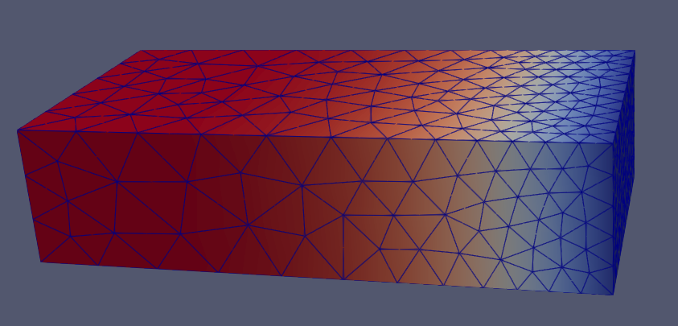
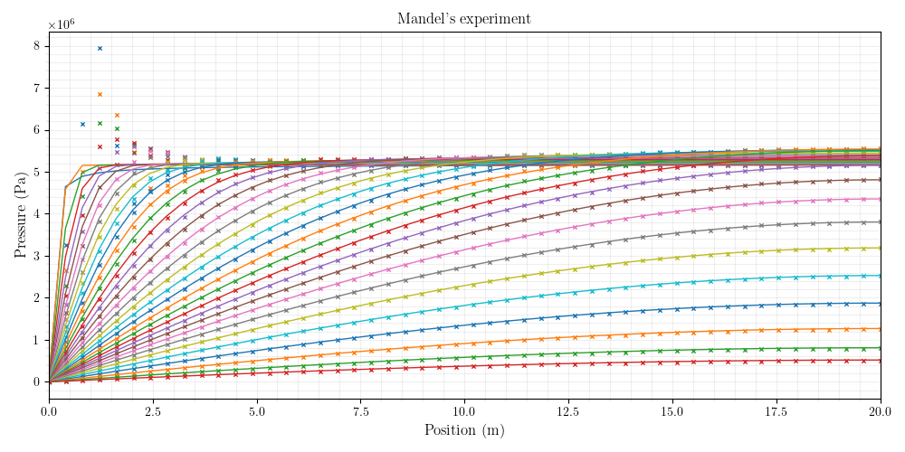
MANDEL – CRANK NICHOLSON
Mesh Information:
elem_dimensions()={3}
spatial_dimension()=3
n_nodes()=3188
n_local_nodes()=858
n_elem()=1756
n_local_elem()=439
n_active_elem()=1756

Slide 12
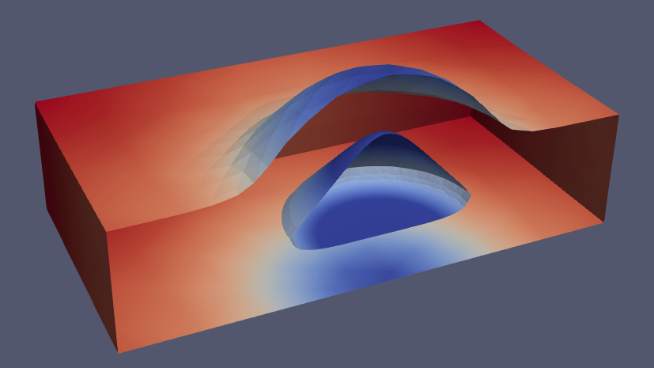
Mesh Information:
elem_dimensions()={3}
spatial_dimension()=3
n_nodes()=18045
n_local_nodes()=4867
n_elem()=12115
n_local_elem()=3028
n_active_elem()=12115
MASS BALANCE
197s

Slide 13
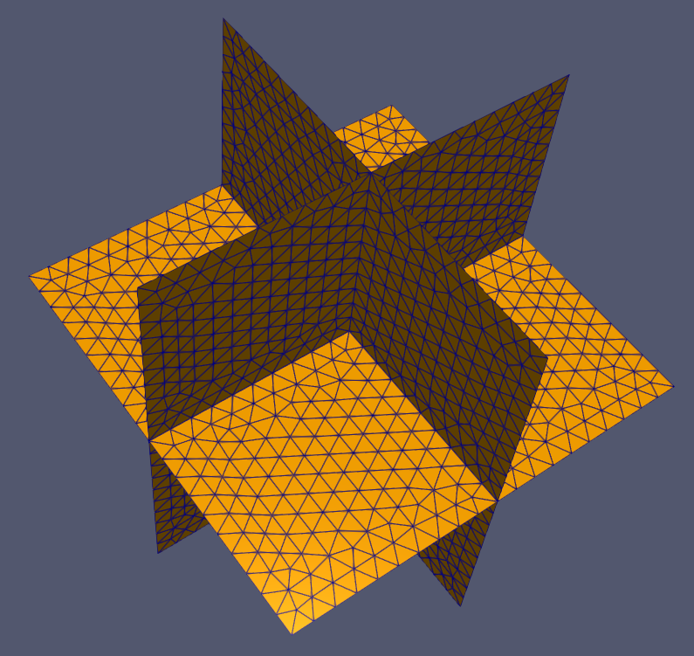
Maxsize = 2

Slide 14
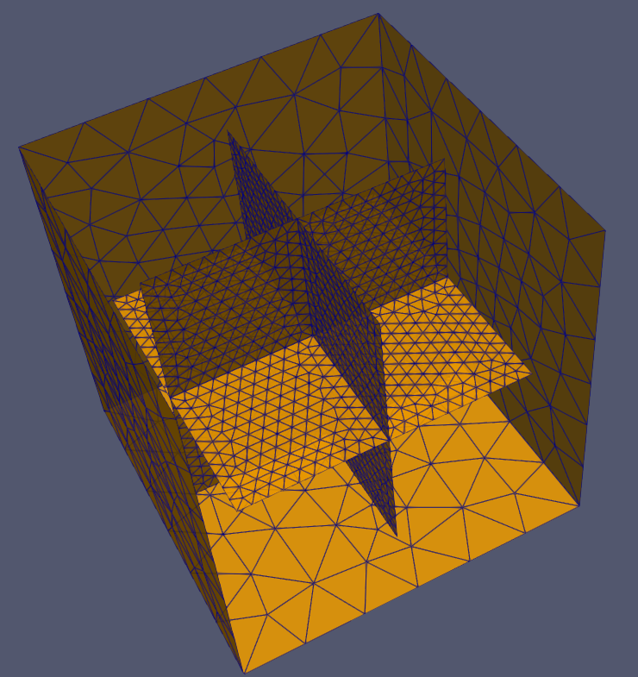
Maxsize = 2

Slide 15
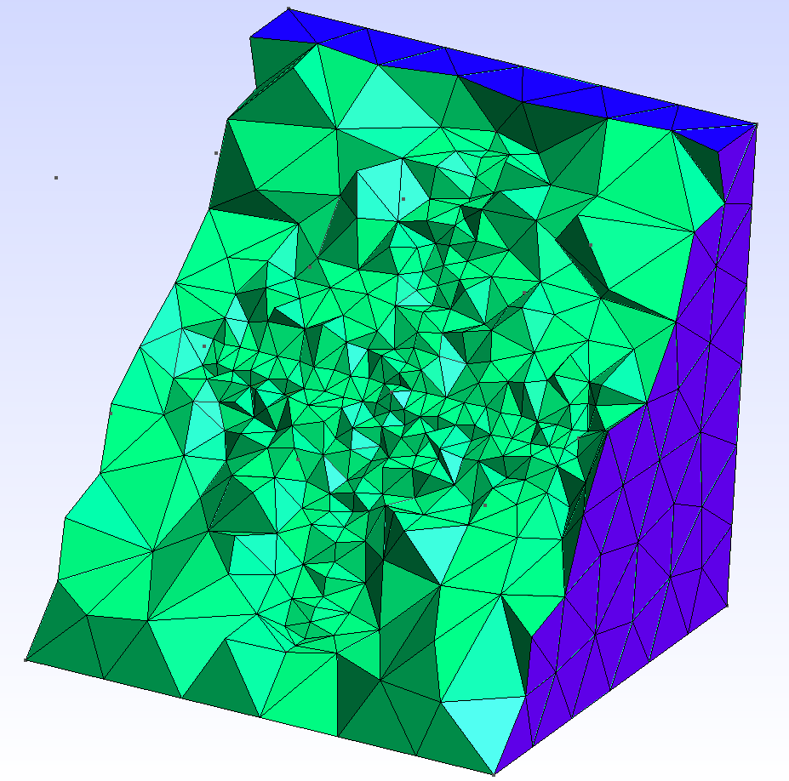
Maxsize = 2

Slide 16
Convergence

Slide 17
Convergence

Slide 18
Convergence

Slide 19
Performance

Slide 20
Notes
Validate with poroelastic solution of Detournay
PKN model
Avoiding transients. Trying to use only linear steady-state

